Slide 1




Exploring the Exciting World of Modern .NET Development
Matthew Leibowitz @mattleibow

Slide 2
About Me
South African
Left SA in 17
Been 7 since I have been back
Developer at Xamarin for just over 2 years
Developer at Microsoft for 8 years

Slide 3
About Me
South African
Left SA on 17 April 2024
Been 77 days since I have been back
Developer at Xamarin for just over 2 years
Developer at Microsoft for 8 years

Slide 4

.NET

Slide 5









.NET
Cloud
Web
Desktop
Mobile
Gaming
IoT
AI
+
+
Visual Studio
Visual Studio Code
CLI
Linux
NuGet
GitHub
Components, tools, library vendors
Windows
macOS
Tools
Operating system
Ecosystem

Slide 6




Any Platform
Blazor
.NET MAUI

Slide 7
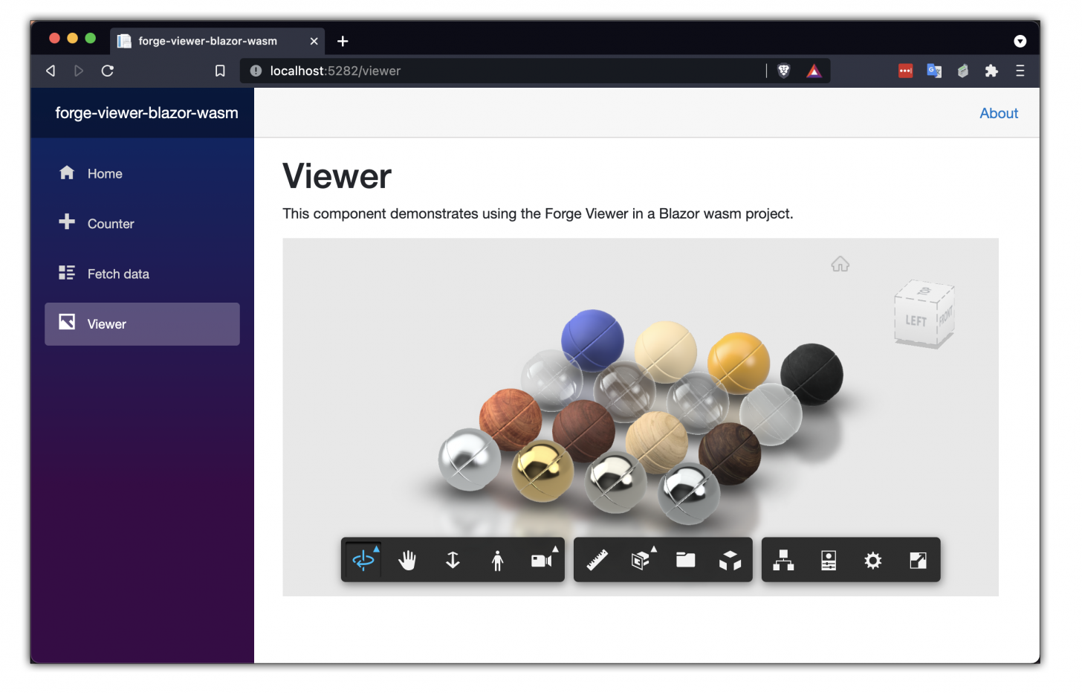
Blazor

Slide 8
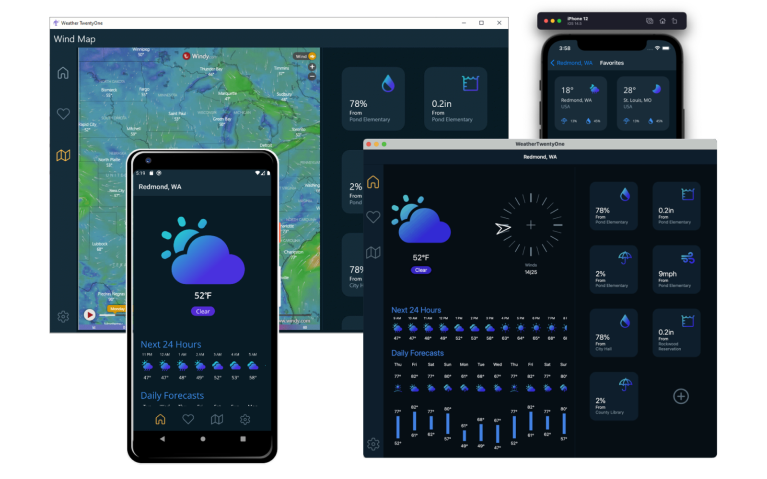
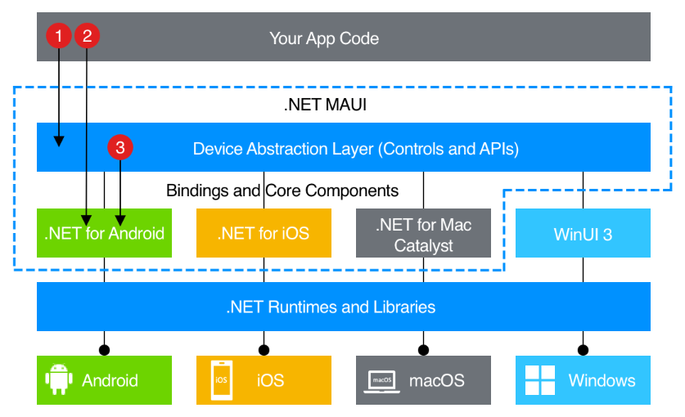
.NET MAUI

Slide 9

BLAZOR
C#, HTML, CSS
BLAZOR + .NET MAUI
.NET MAUI, WinUI, WPF
C#, XAML
Reach
Depth
Websites and PWAs
Hybrid
Native

Slide 10
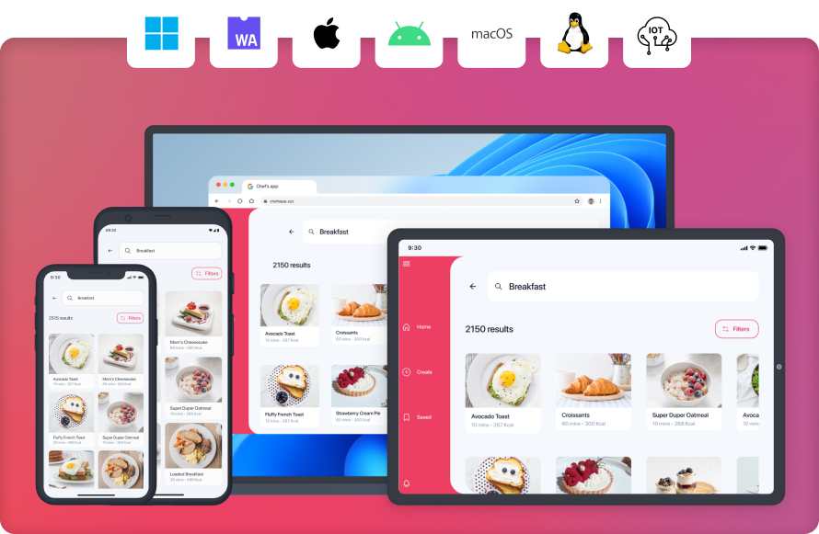

Slide 11
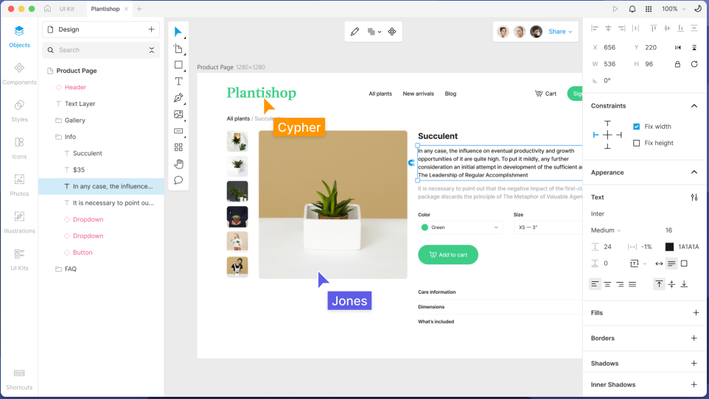
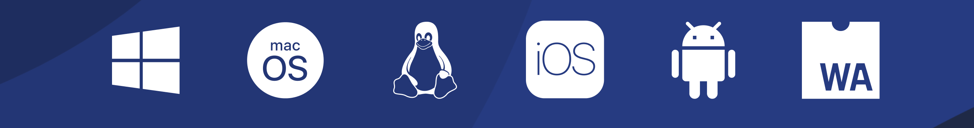

Slide 12

Visual Studio Code

Slide 13
Visual Studio Code
Lightweight
Powerful
Source code editor
Windows, macOS, Linux
Rich ecosystem Extensions

Slide 14
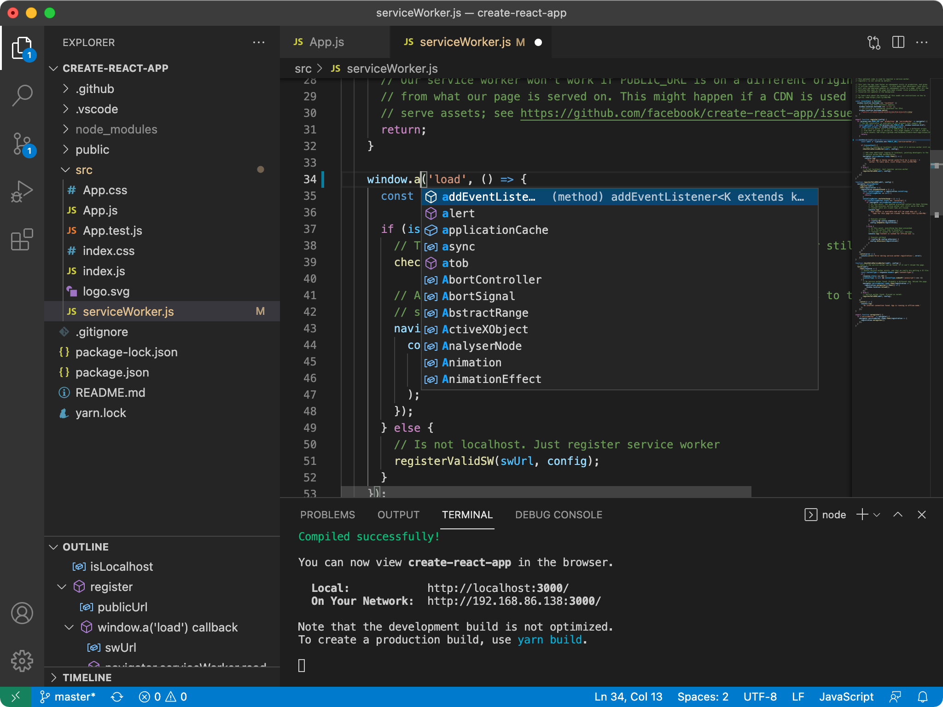

Slide 15

C# Dev Kit for Visual Studio Code

Slide 16
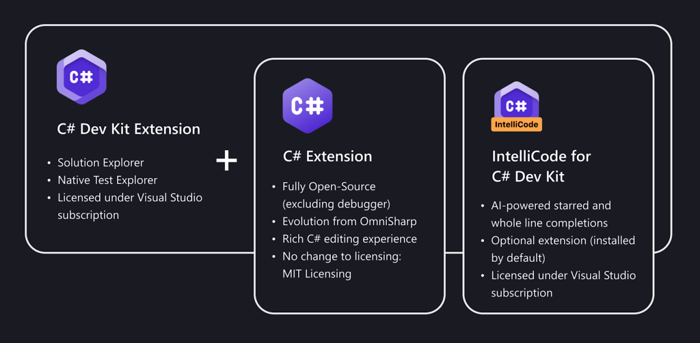

Slide 17

.NET MAUI Dev Kit for VS Code

Slide 18
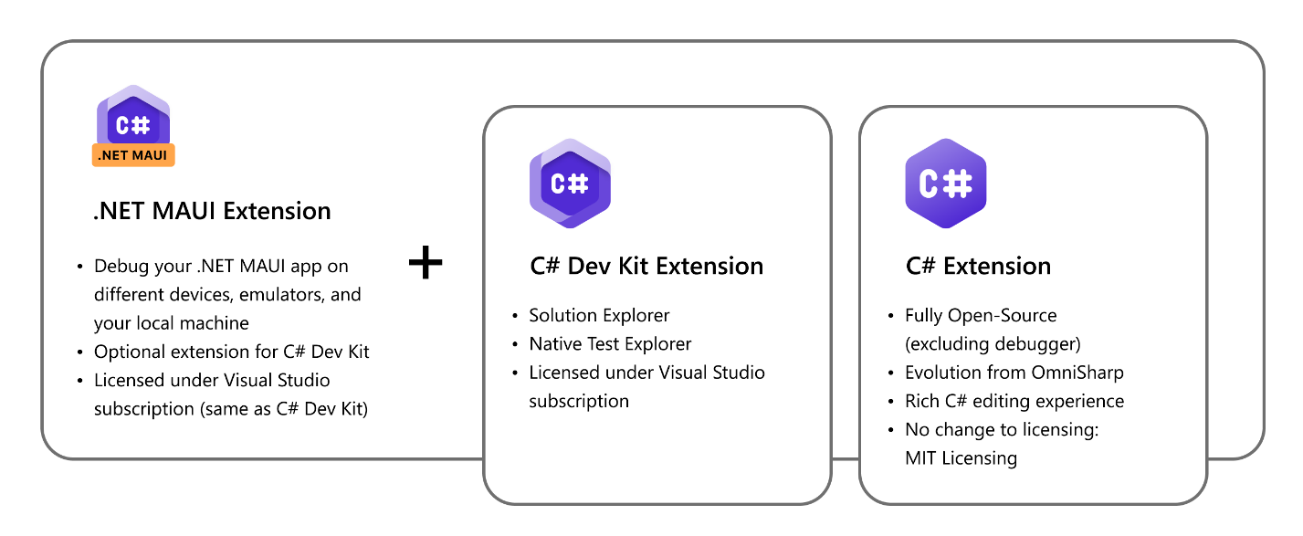

Slide 19


Docker and Containers

Slide 20
Ensures consistent application behavior
Lightweight and efficient
Enhances application security
Ideal for microservices architectures
Supported by a robust community and ecosystem
Runs seamlessly across different platforms
Application Containerization

Slide 21






Client
Host
Registry
Daemon
docker pull
my-app-ai
my-app-db
docker build
my-app-api
my-app-web
.NET
.NET
docker run
.NET
.NET
Containers
Images

Slide 22
MS SQL Server on macOS
docker pull mcr.microsoft.com/azure-sql-edge:latest
docker run \
-e "ACCEPT_EULA=Y" \
-e "MSSQL_SA_PASSWORD=MyPass@word" \
-p 1433:1433 \
-d \
mcr.microsoft.com/azure-sql-edge:latest

Slide 23
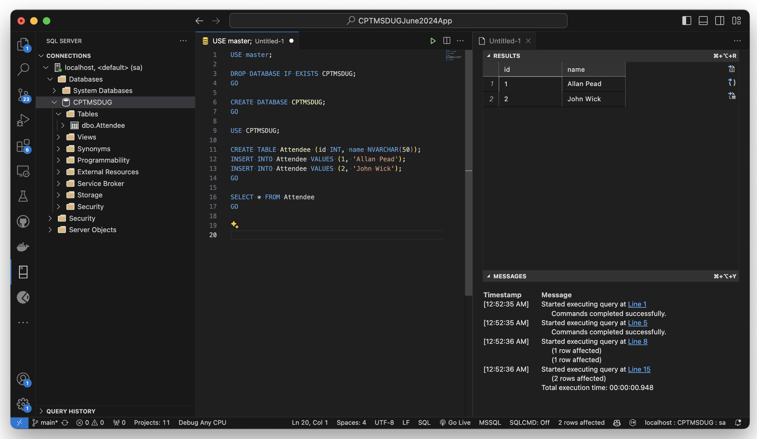
MS SQL Server on macOS

Slide 24

Dev Tunnels

Slide 25
Local Endpoint
Public Endpoint
Anything
Dev Tunnel
http://localhost:5000/...
https://myapp-5000.devtunnels.ms/...

